Slide 1
DSO 545 Final Project
State Presidential ELECTIONs
Akshay Bhide, JiNyu CHEN, Keegan O’neill, Pratik Khadse, Sebastian Cahill, Yang Song
Abstract: The purpose of this project is to investigate which factors may affect presidential election outcomes on a state-by-state basis. The timeframe for this study is from 1984 to 2020. The analysis includes descriptive statistics of the dataset as well as regressions to assist with predictions.

Slide 2
01
Introduction

Slide 3
problem & Data set
*Key Measure (Dependent Variable)
Net Votes/Net Votes Pct represent the difference in popular vote between the Dem. party and Rep. party. The metric represents 2 important points. A positive figure indicates a Dem. majority win, while negative represents a Rep. majority win. The figure also represents how wide the gap between these two parties was from a total vote perspective
Given the surge in media attention and growing polarization surrounding US presidential elections, it has become increasingly important for candidates to understand who their constituents are and how to address them throughout their campaigns.
One way for candidates to get a better understanding is to dissect historical elections on a state-by-state basis and understand which factors lead to one party winning the majority of the popular vote. Of particular interest is a change in party selection from one election to another.
Our study analyzes readily available state demographic and political data. By running regressions with the vote differential between the two major parties* (Democrat/Republican) as the dependent variable, and the other data as independent variables, we can see how changing demographics and political landscapes might affect future election outcomes.

Slide 4
FACTORS AFFECTING ELECTION RESULTS
01
02
03
04
05
06
Median Income
VOTER TURNOUT
incumbent
The state’s median household income* for each election year
Percentage turnout of the state’s eligible voters for each election year
The party of the current president on election day
House & senate majority
SPENDING VARIABLES
Population
The Party which has the majority in the House and Senate for each election year
Campaign spending* by Democratic and Republican candidates on a national level for each election year
Population of state’s eligible voters for each election year
* adjusted for inflation to 2020 dollars

Slide 5
Step 1: Data research and Cleaning
We began with a dataset on state-level presidential election results
We then selected variables (see previous slide) we believed to be relevant that were publicly available
Sourced data for selected variables and merged into a single dataset
Multiple sources were referenced for the same variable in some instances in order to have a complete set of data for our chosen timeframe of election years
Data from sources that were not in a tabular format were manually incorporated
Inspection of dataset revealed duplicate as well as missing data
Researched missing data and manually incorporated values; deleted duplicate values
Yearly national campaign spending data was adjusted for inflation to the year 2020 through a US inflation rate calculator
Cleaned and formatted data into master file using Python
*- between the two major parties

Slide 6
02
Dashboard & EDA

Slide 7
dASHBOARD INTRO
DESCRIPTION
Potential UserS
Business Executives whose businesses will be affected by election results
Political Consultants who are interested in predicting state outcomes, for either academic, business, or political purposes
GOALS
Goals
Help predict who will elections at both the national and state level
Which audience should be targeted to best allocate campaign resources
Help candidates determine when it is best to run for office

Slide 8
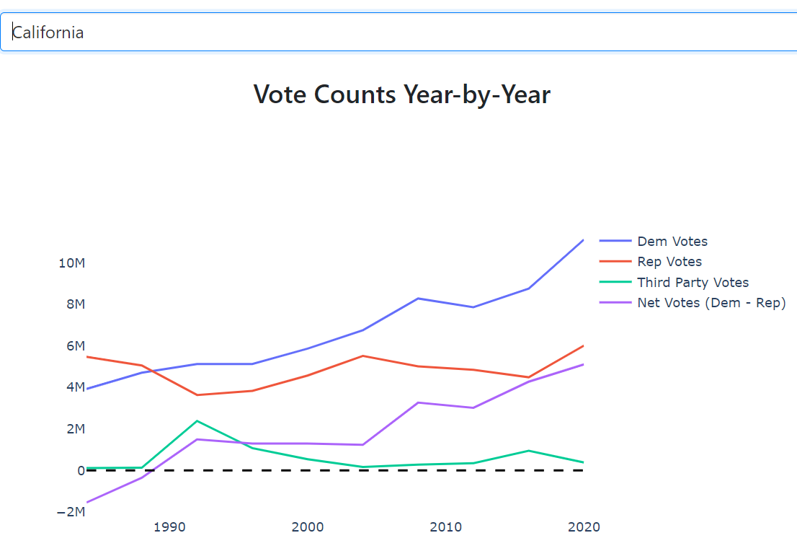
State Vote Count Line PLot
Shows gross votes over time for each of the major parties
Shows the difference in votes between major parties over time (Net Votes)
Dashed line: Net Votes threshold - Net Votes above the line correspond to a Democratic candidate winning, Net Votes below the line corresponds to a Republican candidate winning the state

Slide 9
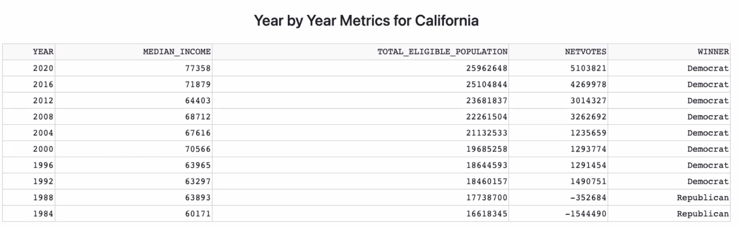
Additional information by state

Slide 10
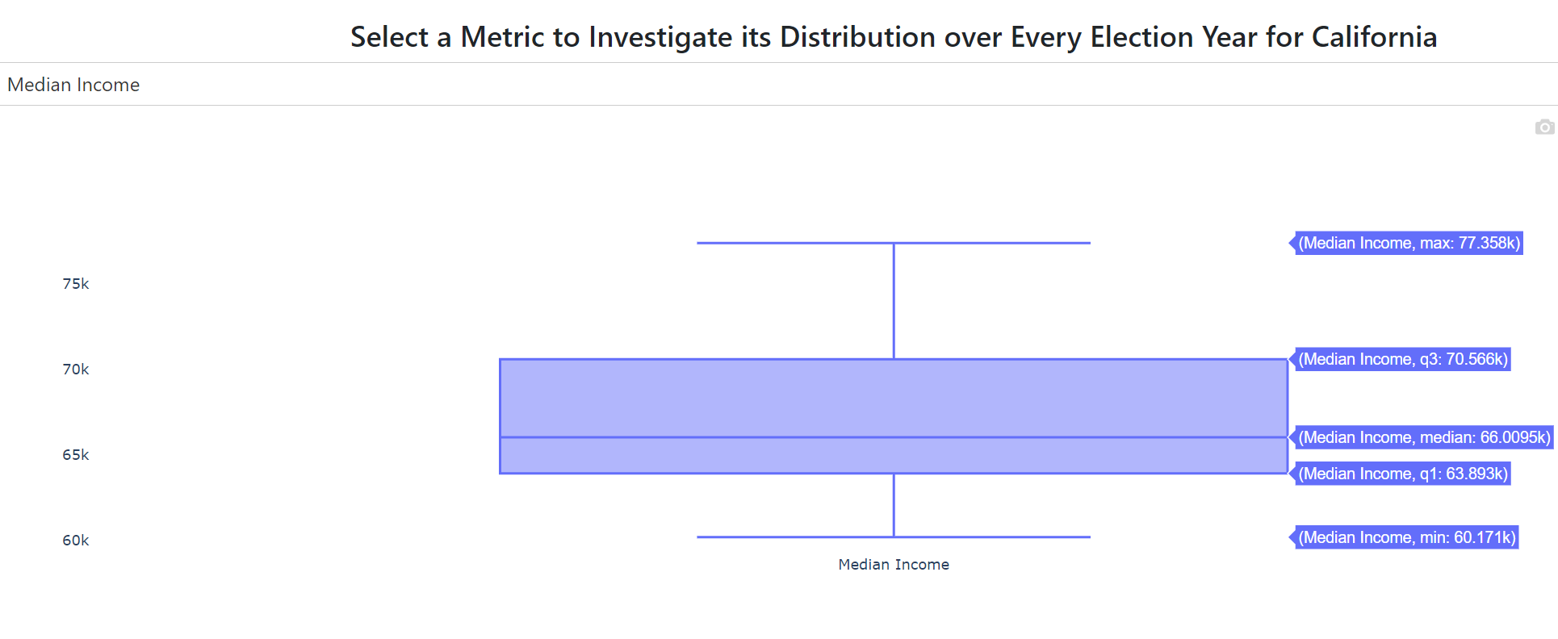
State Metric Box PLot
Shows the over distribution of a specific metric for each state over all election years in our chosen time frame (1984 to 2020). This helps in interpreting how populations within a state evolved historically.
Metrics: Median income, Voter turnout percentage, Voting population size, Democrat votes, Republican votes, and Net Votes (Democrat votes minus Republican votes)

Slide 11
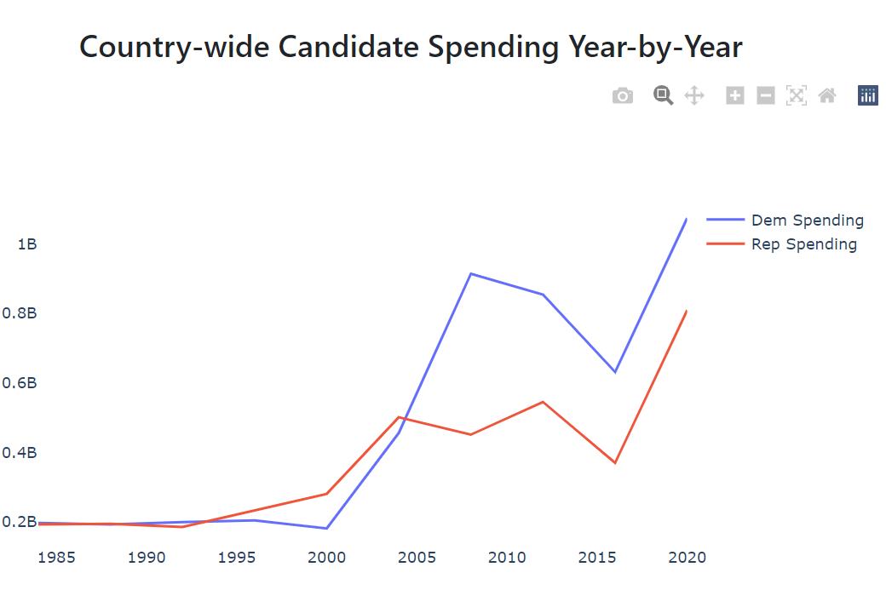
National Candidate Spending Line Plot
Shows the spending for both major parties over time. This is at the national level as state-level data is unavailable. The figure is displayed next to the previous line plot on the dashboard in order to compare changes in votes over time with changes in candidate spending over time.

Slide 12
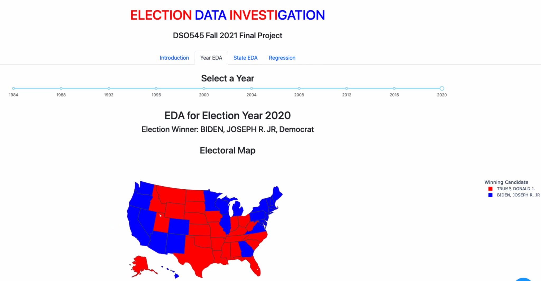
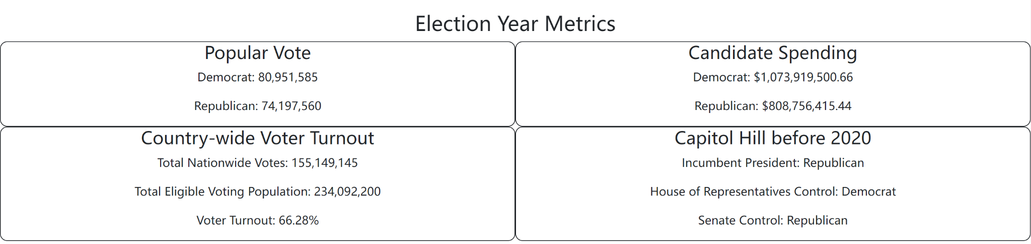
eLECTOrAL Information by Year

Slide 13
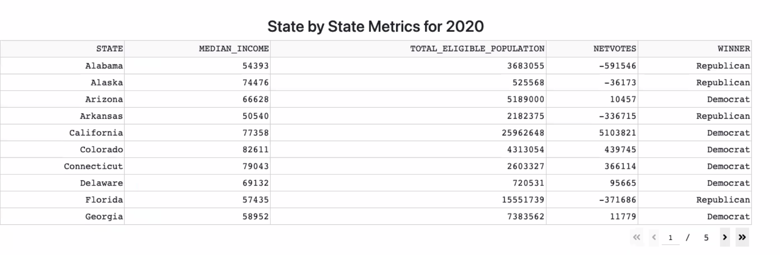
aDDITIONAL iNFORMATION By Year

Slide 14
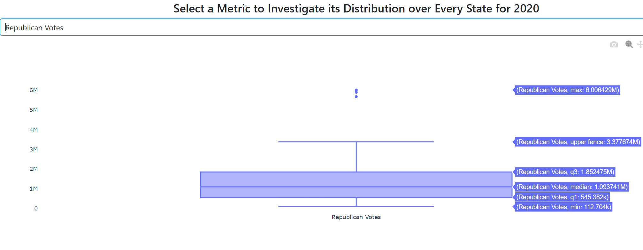
Year Metric Box PLot
Shows the distribution of a specific metric for each year (Using data from all 50 states). This helps in interpreting how populations across states varied for one specific election year.
Metrics: Median income, Voter turnout percentage, Voting population size, Democrat votes, Republican votes, and Net Votes (Democrat votes minus Republican votes)

Slide 15
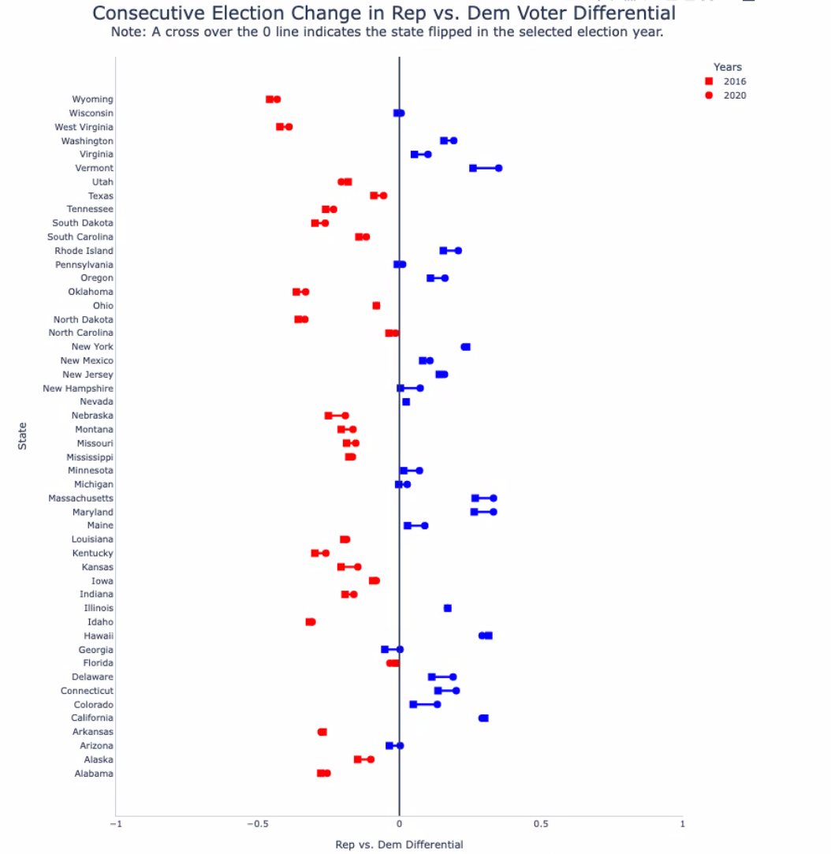
State-level net votes
Change Since Last Election
This chart reveals changes in voter behavior from one election to the next. On the y-axis is the state name, while the x-axis plots the Net Vote Percentage (as explained on slide 3) for the two consecutive election years. We can see the direction of the change and whether it is converging to 0 (more even vote split) or diverging from 0 (1 party takes strong lead in state)
For 2020 for example, we can see states like Georgia and Arizona cross over the 0 line, indicating they flipped from one party to another.

Slide 16
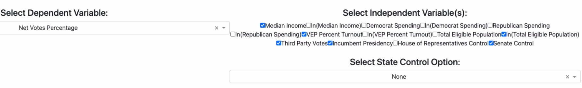
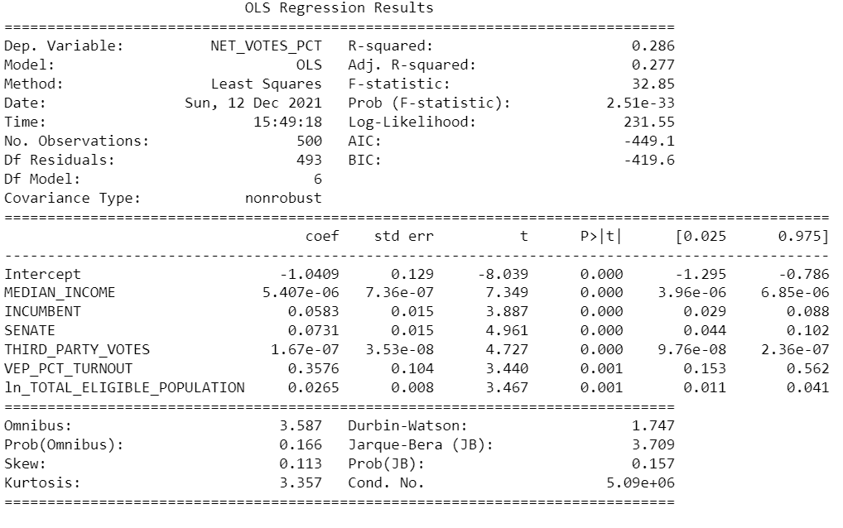
Regression Analysis
**Initial regression model and residual plot of Total Eligible Population in appendix**

Slide 17
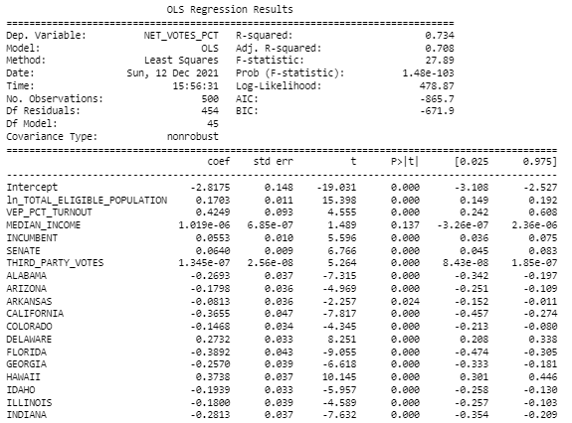
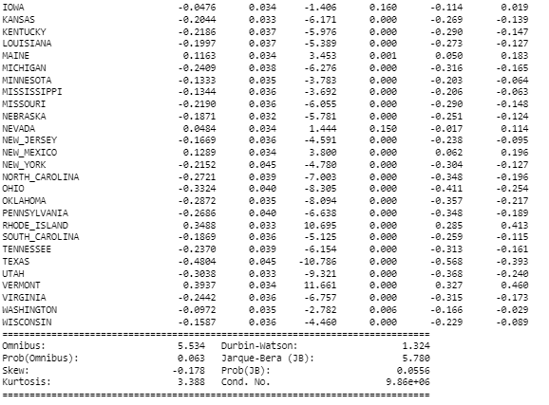
Regression Analysis II
**Initial model with all state variables in appendix**

Slide 18
04
Appendices

Slide 19
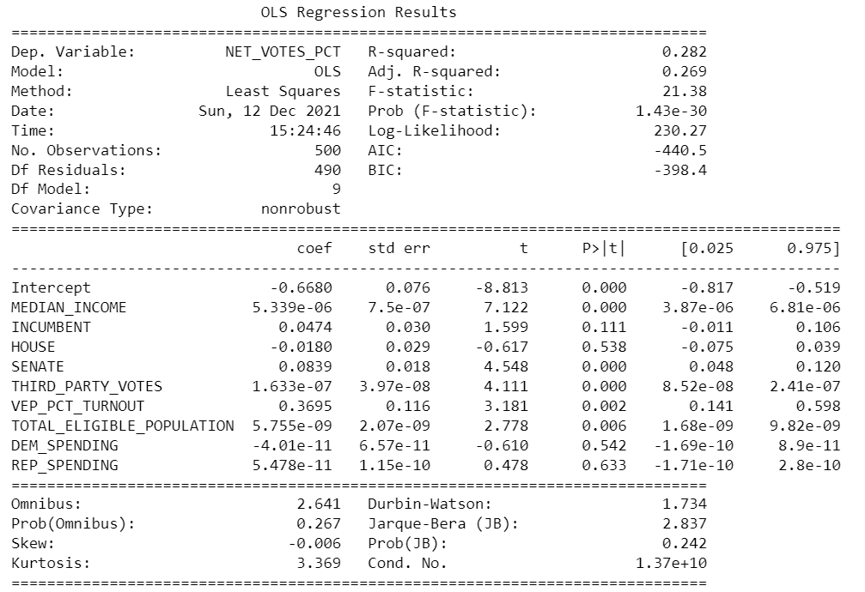
Initial Regression Model

Slide 20
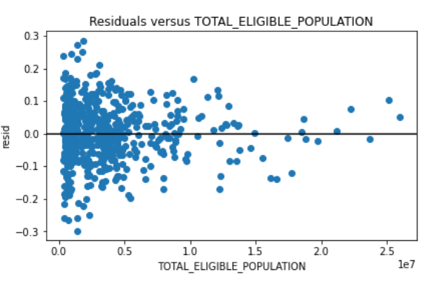
Residual PLot of Total Eligible Population

Slide 21
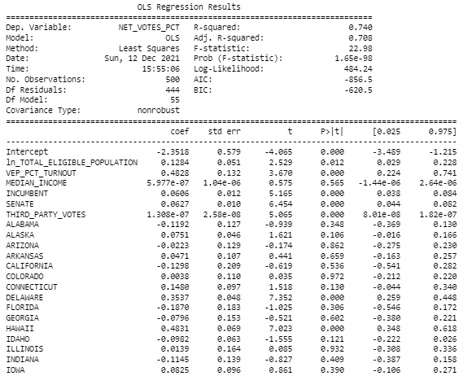
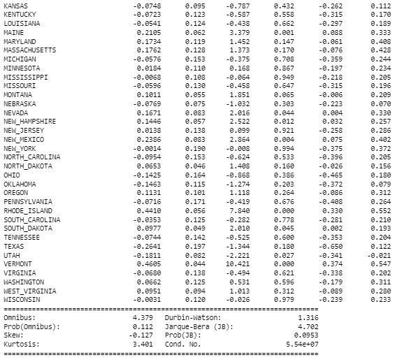
Initial Regression Model with State Variables

Slide 22
Sources I
“1976-2020-President.Tab - U.S. Presidential Elections.” Harvard Dataverse, https://dataverse.harvard.edu/file.xhtml?fileId=4299753&version=6.0. Accessed 12 Dec. 2021.
“Annual Estimates of the Total Population for States | Iowa Community Indicators Program.” Iowa Community Indicators Program (ICIP) | Iowa Community Indicators Program, https://www.icip.iastate.edu/tables/population/states-estimates. Accessed 12 Dec. 2021.
Bureau, Census. “Historical Income Tables: Households.” Census.Gov, https://census.gov /, 9 Nov. 2021, https://www.census.gov/data/tables/time-series/demo/income-poverty/historical-income-households.html.
“Decennial Census Population Counts for States | Iowa Community Indicators Program.” Iowa Community Indicators Program (ICIP) | Iowa Community Indicators Program, https://www.icip.iastate.edu/tables/population/census-states. Accessed 12 Dec. 2021.
“Historical Presidential Election Information by State.” 270toWin.Com, https://www.facebook.com/270toWin, https://www.270towin.com/states/. Accessed 12 Dec. 2021.
“Inflation Calculator | Find US Dollar’s Value from 1913-2021.” US Inflation Calculator | https://www.usinflationcalculator.com/. Accessed 12 Dec. 2021.
Leip, David. “Dave Leip’s Atlas of U.S. Presidential Elections.” Dave Leip’s Atlas of U.S. Presidential Elections, https://uselectionatlas.org/RESULTS/. Accessed 12 Dec. 2021.

Slide 23
Sources II
“Party Divisions of the House of Representatives, 1789 to Present: US House of Representatives: History, Art & Archives.” Party Divisions | US House of Representatives: History, Art & Archives, history.house.gov/Institution/Party-Divisions/Party-Divisions/. Accessed 12 Dec. 2021.
“Party Division.” U.S. Senate: Party Division, 28 Jan. 2021, www.senate.gov/history/partydiv.htm. Accessed 12 Dec. 2021.
“Spending: By the Numbers | FEC.” FEC.Gov, https://www.fec.gov/data/spending-bythenumbers/?office=P&election_year=1984. Accessed 12 Dec. 2021.
Statistics_Data_Facts. “US Presidential Election Spending by Candidate over the Years.” Statistics_Data_Facts, Blogger, 19 Dec. 2020, https://www.stadafa.com/2020/12/us-presidential-election-spending.html. Accessed 12. Dec. 2021
“U.S. VEP Turnout 1789-Present - Google Sheets.” Google Docs, https://docs.google.com/spreadsheets/d/1bH38j6_e8yA9xq8OMlyLOL6h_iTS7ABQMKNxzFgKBDo/edit#gid=435419492. Accessed 12 Dec. 2021.
“Voter Turnout Data - United States Elections Project.” United States Elections Project, http://www.electproject.org/home/voter-turnout/voter-turnout-data. Accessed 12 Dec. 2021.
“Voter Turnout in Presidential Elections | The American Presidency Project.” Welcome to The American Presidency Project | The American Presidency Project, https://www.presidency.ucsb.edu/statistics/data/voter-turnout-in-presidential-elections. Accessed 12 Dec. 2021.

